Slide 1

Share Portfolio Prediction
Stakeholders:
Charles Franklin (CEO)
Flynn Minder (Operations Manager)
Andrew Hooper (Head of Trading)
Presented by: Bernd Edlinger (Data Scientist)

Slide 2

Bio
Education
- Bachelor of Commerce (Financial Management)
- Data Science (Institute of Data)
Experience
- 14 Years FX and Commodities Trading
- 3 Years as a stockbroker
Skills
- Financial Markets/Products
- Deep Learning
- Data Mining

Slide 3
Agenda
Overview
Business Context
Project Pipeline
Data Science Process
Model Evaluation
Conclusion

Slide 4

Business Context
Dreams can come true in the financial markets but they can also turn into nightmares very quickly
There is no such thing as a sure thing in the financial markets but imagine…
being able to take some of the stress out of the stock market
being able to take a portfolio of stocks and feel confident that the money you invest in them will have a greater chance of bringing returns
We believe that in order to more accurately predict the future price of stocks we cannot look at intra-day data as there is too much noise/sharp movements in it. For this reason we look at the monthly data for the stocks we evaluate

Slide 5

Business Question
Can the future performance of a portfolio of stocks be predicted with a high level of accuracy
Why is this important?
We want more dreams to come true in the financial markets than nightmares

Slide 6
Project Pipeline
Data Acquisition
Data Exploration
Data Pre-processing
Model Building
Model Evaluation

Slide 7
Data
Sourced from:
Yahoo Finance
10 years worth of historical trading data (1 Jan 2008 – 31 March 2018)
This gives us 6 features and 123 observations per stock
Four stocks were used
Quandl
10 years worth of historical trading data (1 Jan 2008 – 31 March 2018)
We only imported 1 feature per stock which had 123 observations
Four stocks were used
There were no missing values
The data used did not need much exploring
We did, however, have to make sure that the data was in a time series format

Slide 8
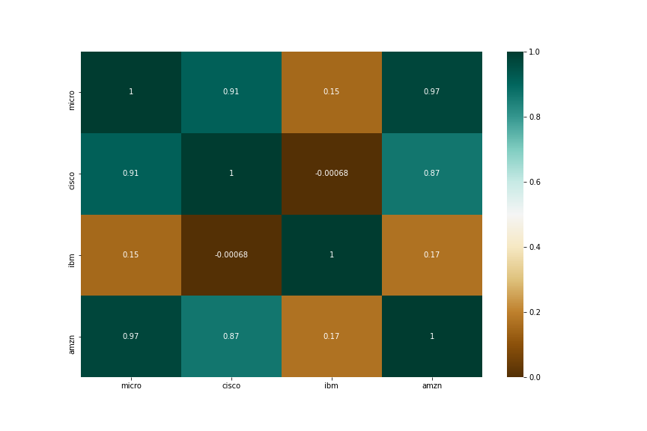
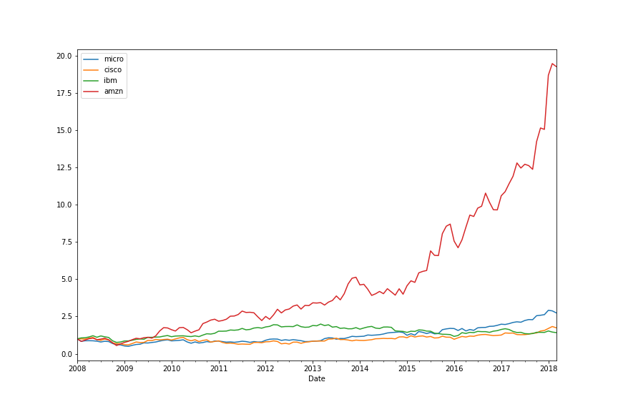
Stock Analysis (Correlation and Normalized price)
As can be seen in the correlation map, some of the stocks are highly correlated and others not at all.
We chose to split our $1million investment Based on the attached chart.
30% to Microsoft
40% to Cisco
20% to IBM
10% to Amazon
Amazon made high returns in the 10 year period but we were worried it may have run too much which is why we only invested 10% of our capital. We didn’t want to miss out completely in case it kept climbing though.

Slide 9
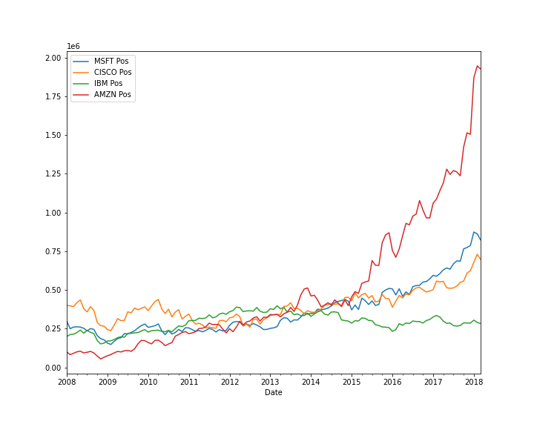
Indication of past performance
Attached is a chart of returns which would have been achieved based on the allocation of funds in each stock.
An initial investment would have yielded 273% cumulative return, Compared to the S&P 500 which returned 83%.
*Past performance is not indicative of future results

Slide 10
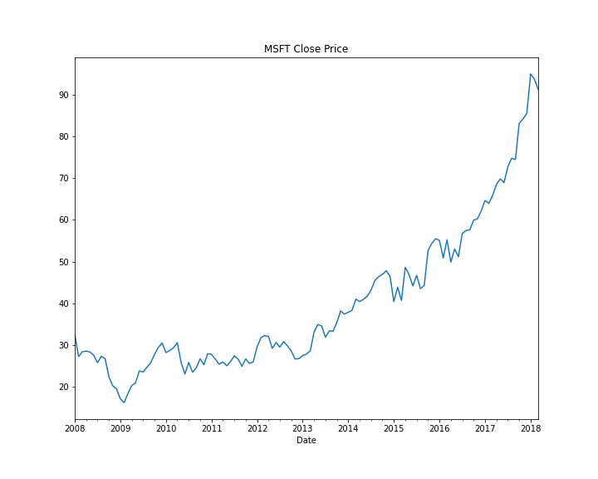
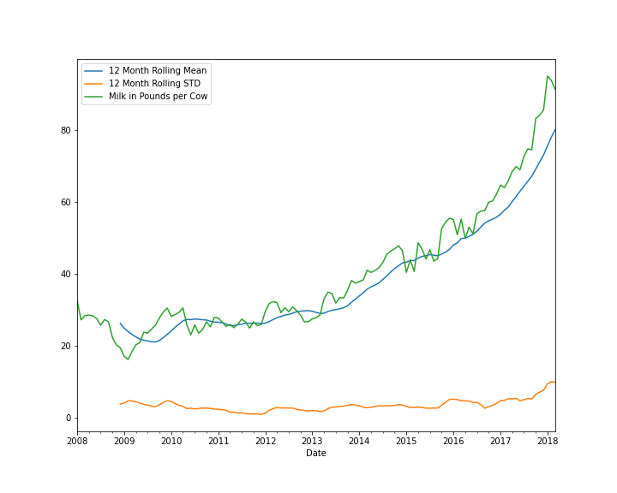
Stock Data Exploration
Here we have a graph of the Microsoft share price from 2008 to 2018
There is clearly an upward trend here
This upward trend is confirmed in the upward trending mean on the second graph

Slide 11
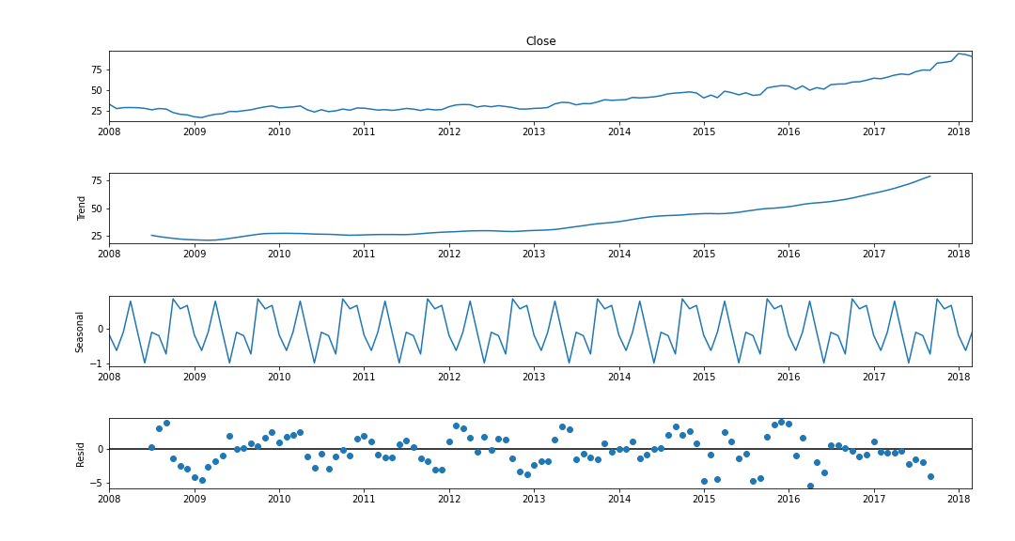
Visualize the time series data
Time series decomposition helps us to better analyze the data and explore different ways to solve the problems
Once again we can see there is a clear trend which lets us know the data is not stationary
There seems to be a pattern in the seasonal window which is why SARIMA was used and produced better results than ARIMA

Slide 12
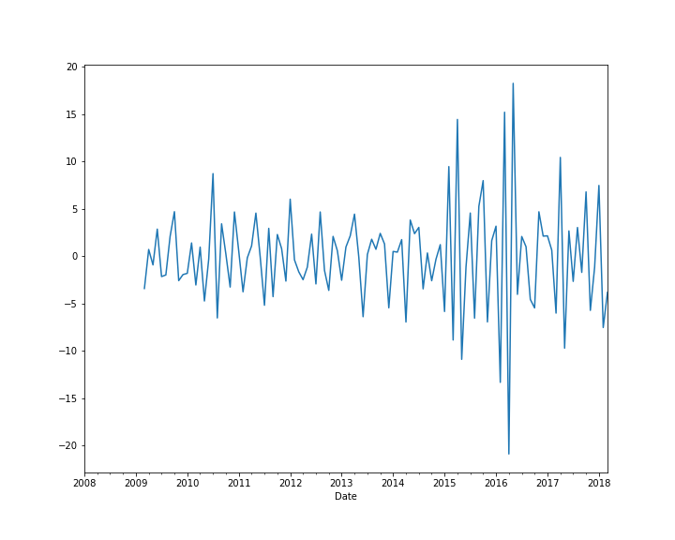
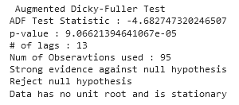
The Dicky-Fuller Test and Differencing
As it is very clear the data was not stationary we had to introduce differencing
Once the data has been differenced we used the dicky-fuller test to see if it is stationary (p-value has to be <= 0.05)
If the data is still not stationary apply differencing again
As can be seen in the attached image and Dicky-fuller test our data is now stationary

Slide 13
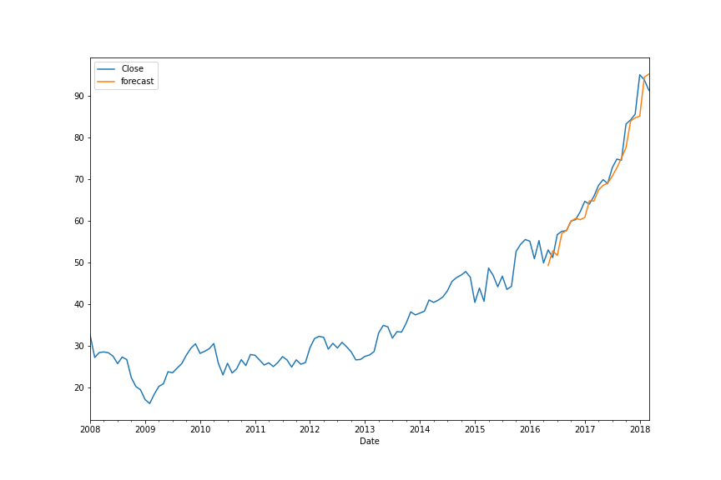
Build the model and forecast
Now that the data is stationary we build the model
We used the SARIMA model
Before we can predict the future performance we have to test it against existing data
The attached chart shows us that the forecast on the data is fairly accurate

Slide 14
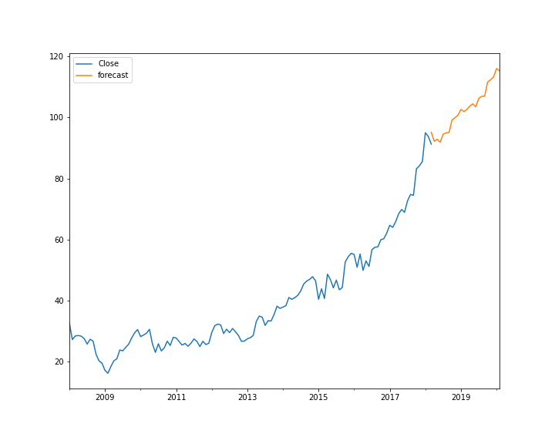
Build the model and forecast
Now that we can see our forecast is accurate we want to see if we can predict future price movements as well
First thing we have to do is create future dates for our prediction
We then use the same prediction method we used on the previous graph on the new dates we created
The blue line indicates historical share prices and the orange line represents the future price projection

Slide 15
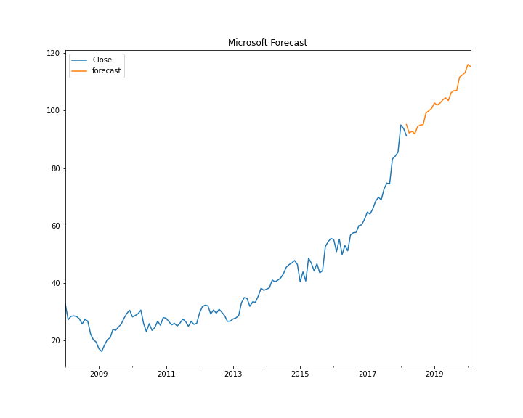
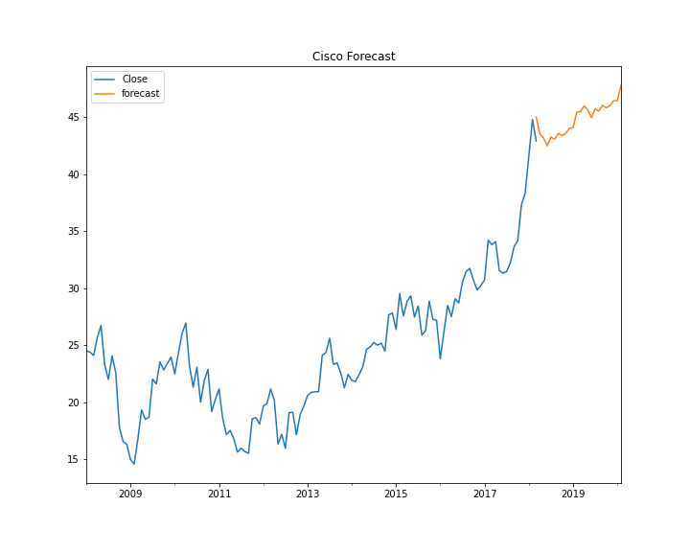
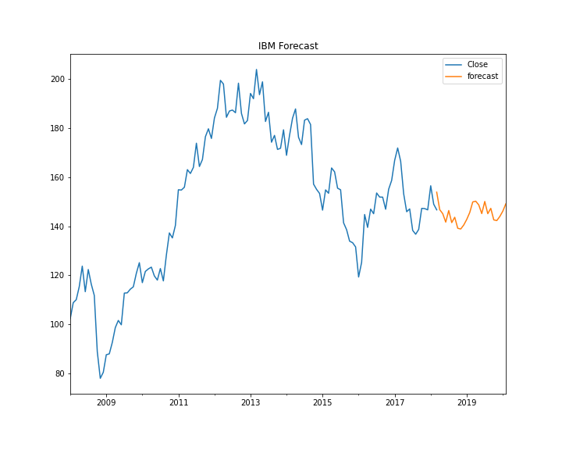
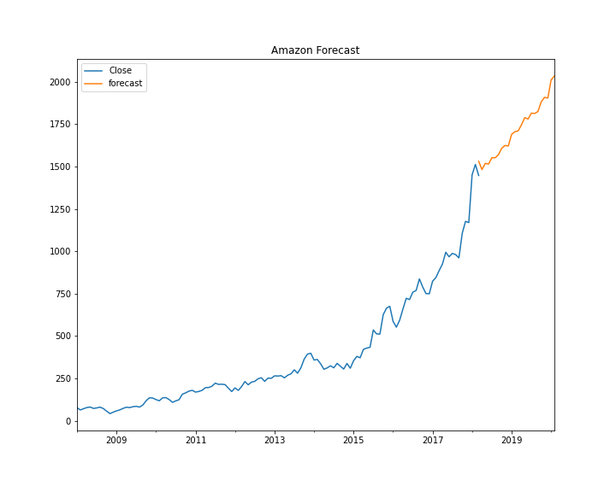
Build the model and forecast
As mentioned earlier, we have only shown the forecast for Microsoft but we used the same process for all four stocks
Attached are the projection images for all four of them

Slide 16

Model Evaluation
Below we have attached our prediction for the individual stocks well as the predicted performance of the portfolio from April 2018 to January 2020. The figures are worked out from the last day of the historical data to the last day of the forecast prediction
 | Microsoft | Cisco | IBM | Amazon | Total Portfolio
Last Historical Price | $91.27 | $42.89 | $146.68 | $1447.34
2 Year Forecast Price | $115.29 | $47.78 | $149.11 | $2034.64
Initial Investment | $300,000 | $400,000 | $200,000 | $100,000 | $1,000,000
Projected Profit | $78,949.34 | $45,604.14 | $3,314.04 | $40,578.10 | $168,445.62
Percentage Return | 26.3% | 11.4% | 1.7% | 40.6% | 16.8%
*As a side note, seeing as this data is older historical data we were able to compare our results to actual market data. Had we invested in this portfolio according to the forecast we would have had a return of 23% which is 6.2% higher than our forecast.

Slide 17
Next Steps and Summary
Summary
We feel the projected forecast is a modest target and is very achievable over the forthcoming two year period
We are forecasting a profit of 16.8% whereas the same portfolio returned a massive 273% during the previous 10 years
Next Steps
Explore the Multi-Step Multivariate LSTM as this will take multiple factors into account when predicting future prices

Slide 18

Thank you
Are there any questions?
Documentation found under:
https://github.com/BerndBE/IOD_DS/tree/main/CAPSTONE
berndbedlinger@gmail.com

